Slide 1



How to Apply for Outdoor Dining Program 2023
Via opengov

Slide 2
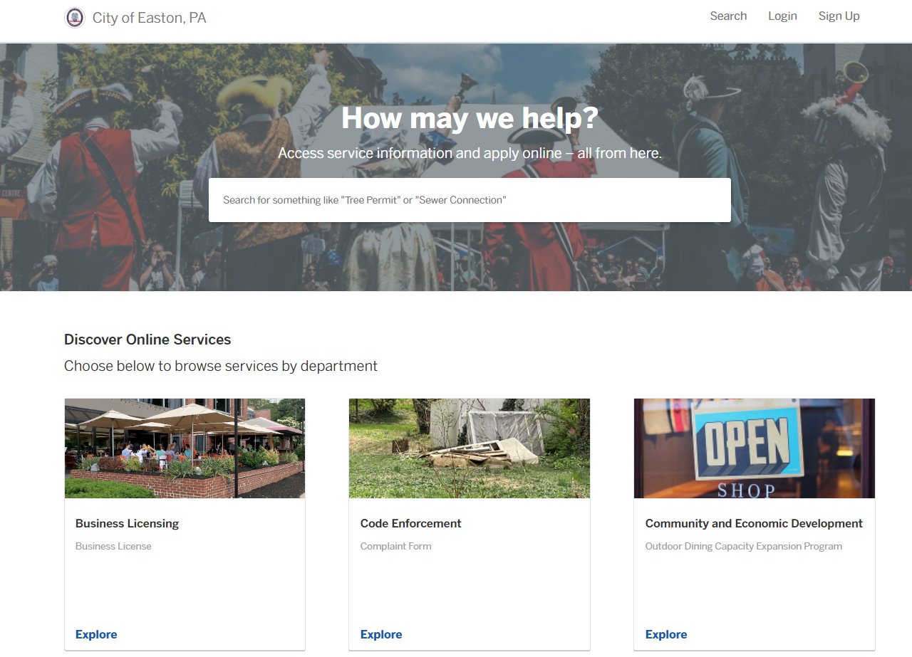
https://eastonpa.viewpointcloud.com/
Once you have opened the site above and signed up for your account, click on “Explore” on the “Community and Economic Development” tab.

Slide 3
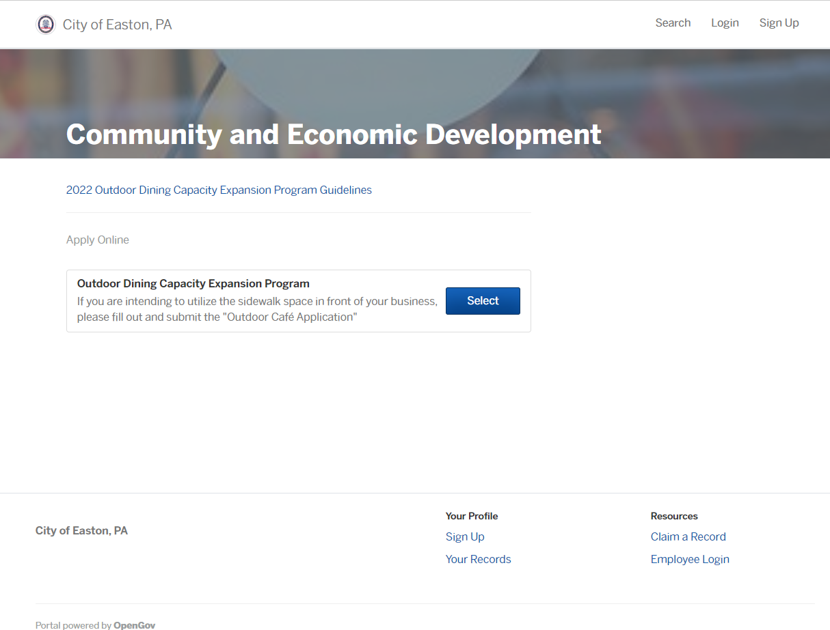
After hitting “Explore”:
You will see the Outdoor Dining Capacity Expansion Program option available to select.
The Guidelines for the program are attached, located above the “Apply Online” option.

Slide 4
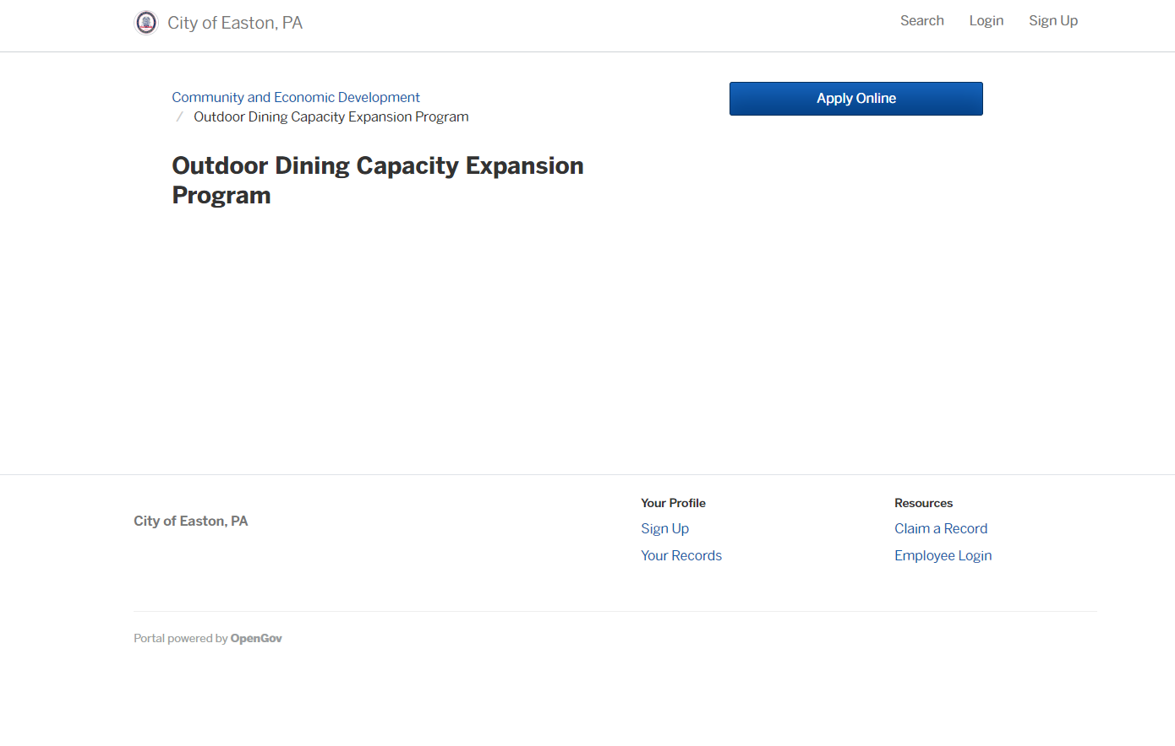
After selecting the program, select “Apply Online”.

Slide 5
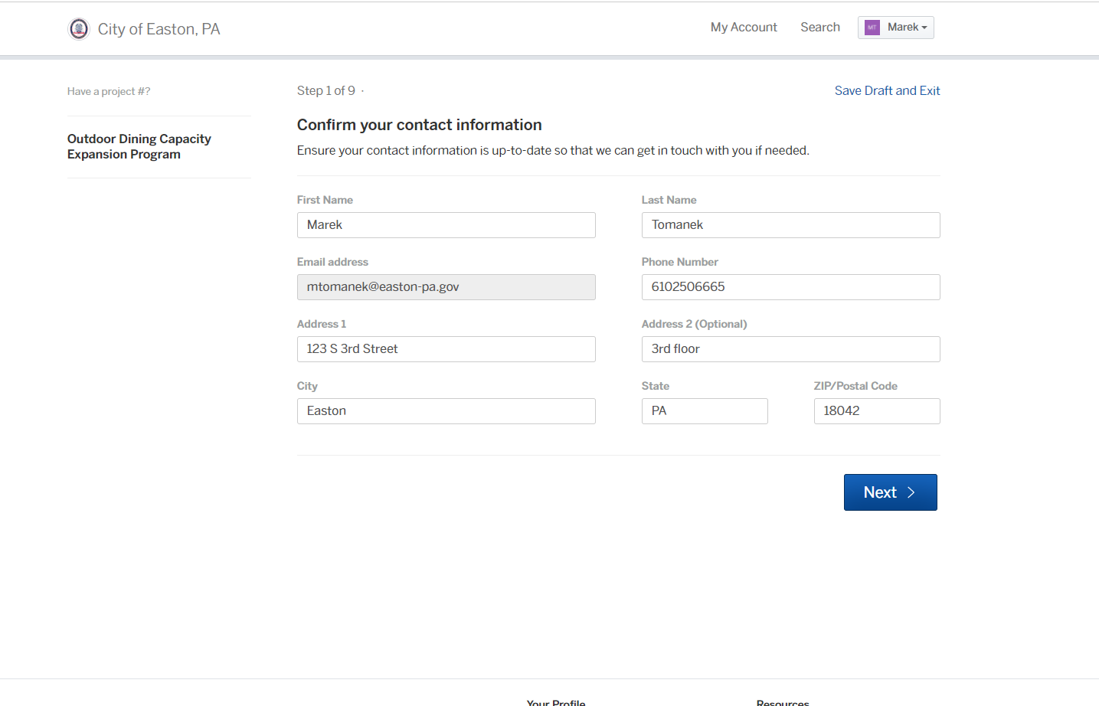
Step 1:
Provide General Contact Information

Slide 6
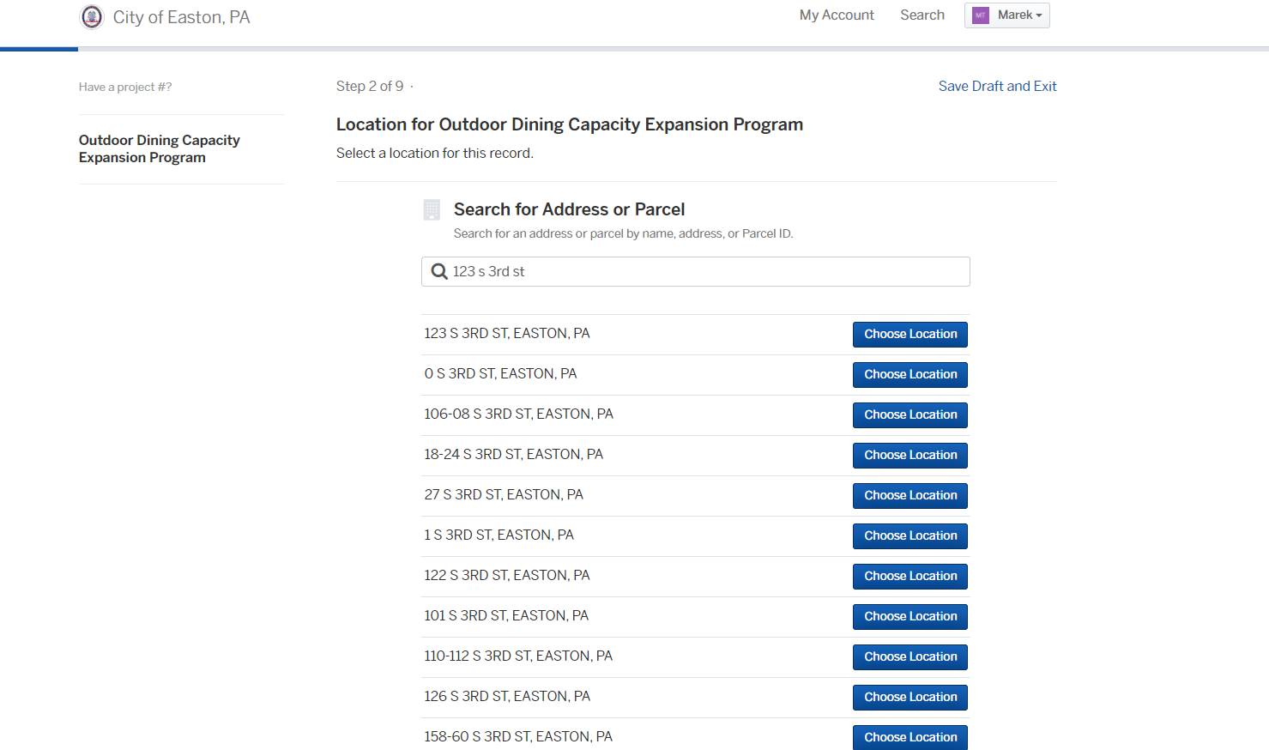
Step 2:
Provide the location of the business
*Please use the tax parcel address for your business location

Slide 7
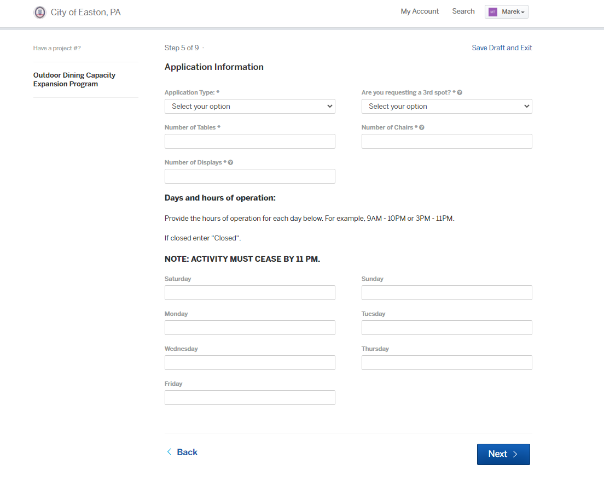
Step 3-4:
Approve the location information and agree to the program’s liability language.
Fill out Application Information

Slide 8
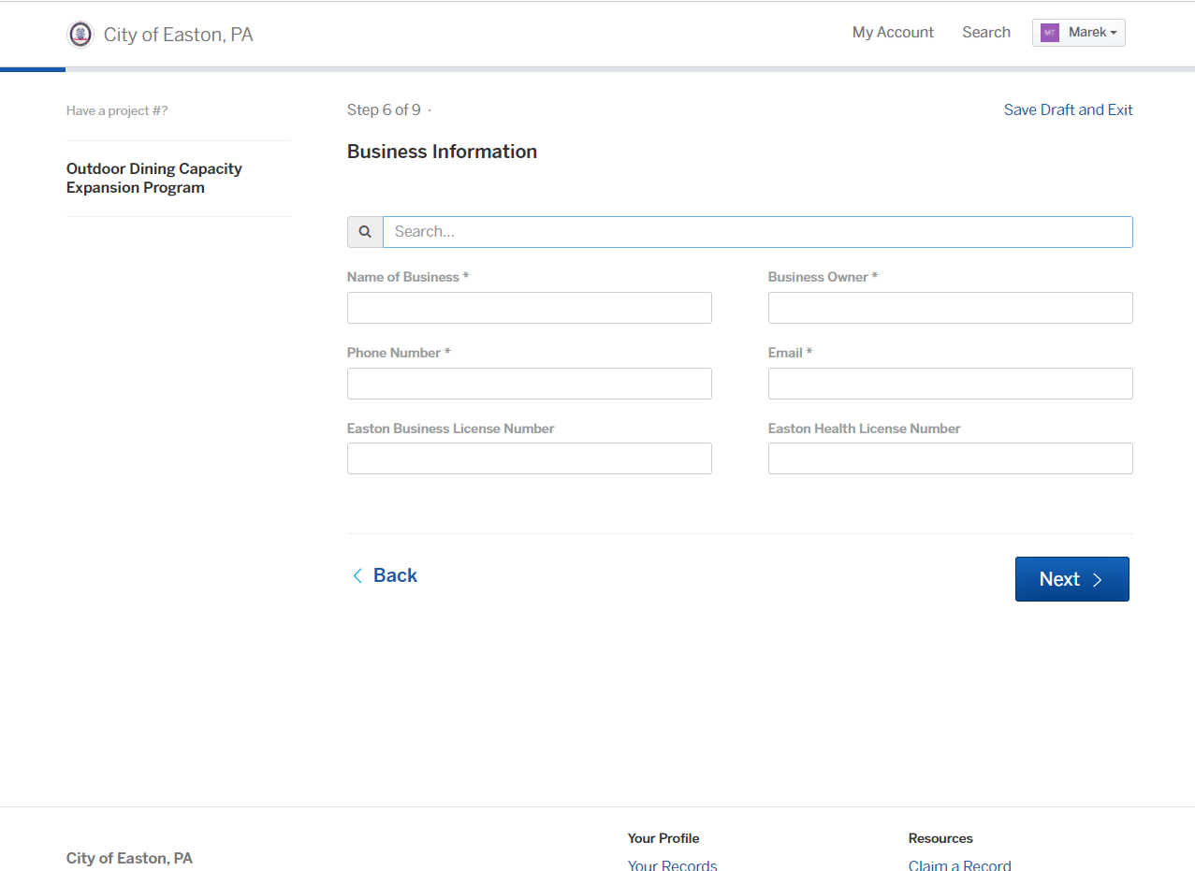
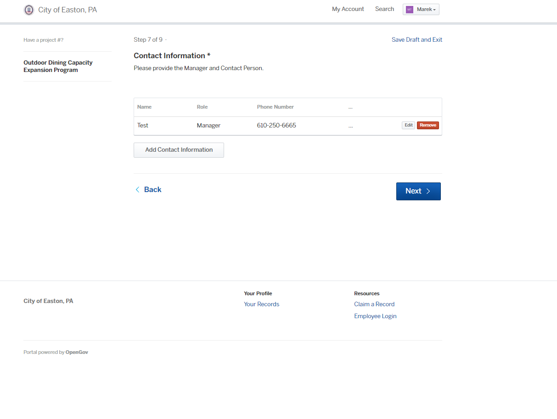
Step 5 & 6:
Fill out Business Information
  (If your business is already enrolled in the system, it should auto populate)
Add contact for this application

Slide 9
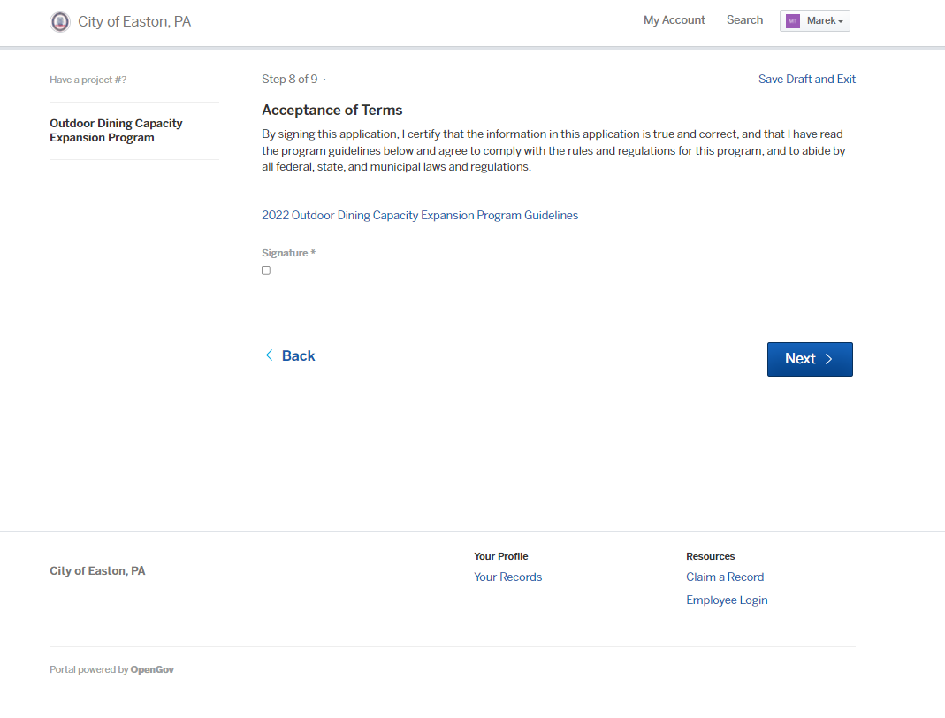
Step 7:
Select the Signature box to acknowledge your acceptance of the regulations contained within the Guidelines.

Slide 10
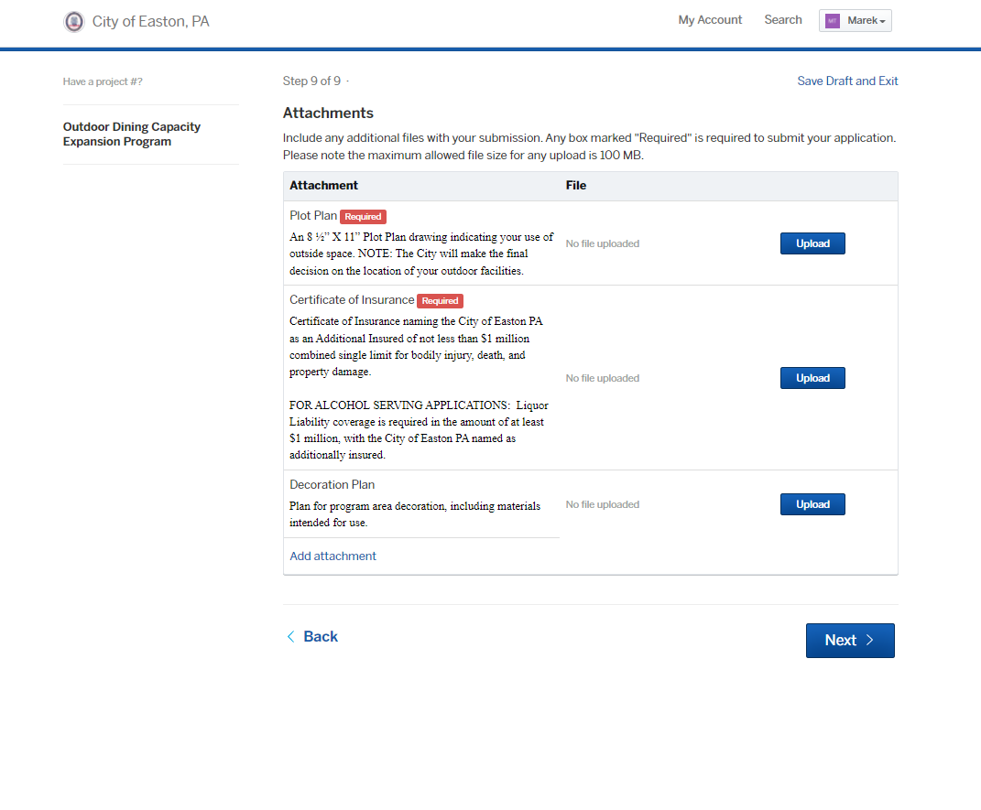
Step 9:
Upload the required plot plan and Certificate of Insurance, as required.
Upload any décor concepts that you plan on implementing.
Select “Next” to move to the payment section.

Slide 11
*If you should have any questions or concerns about how to navigate this program, please contact Sean Ziller at sziller@easton-pa.gov or at 610-250-6623.
Thank you!

